Slide 1

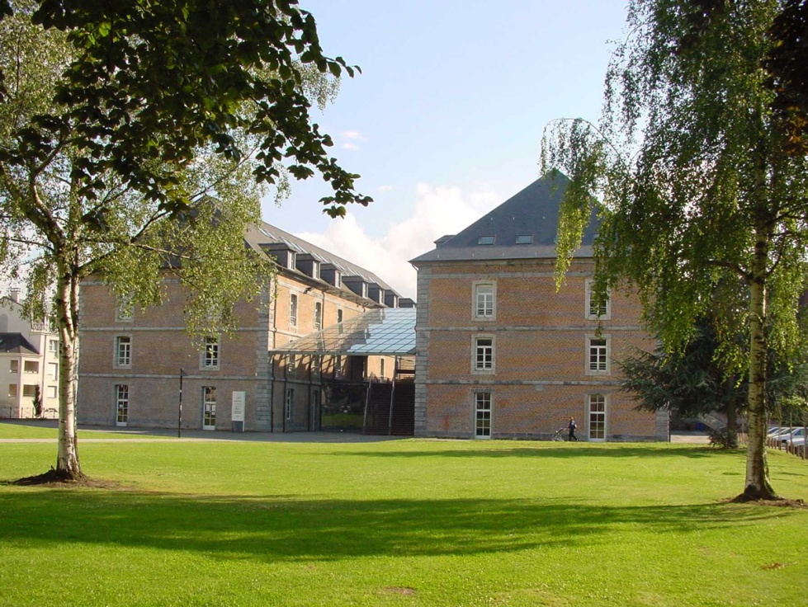
> Located in « Hauts-de-France »
> 5 campus sites
> 10 972 students
> 1,255 international students including 69 nationalities from partner HEI and 117 PhD students

Slide 2

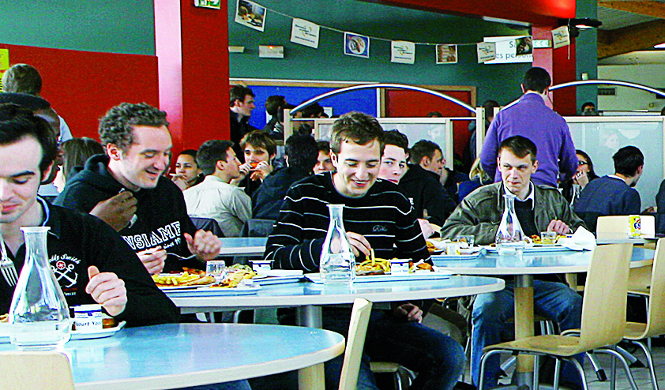

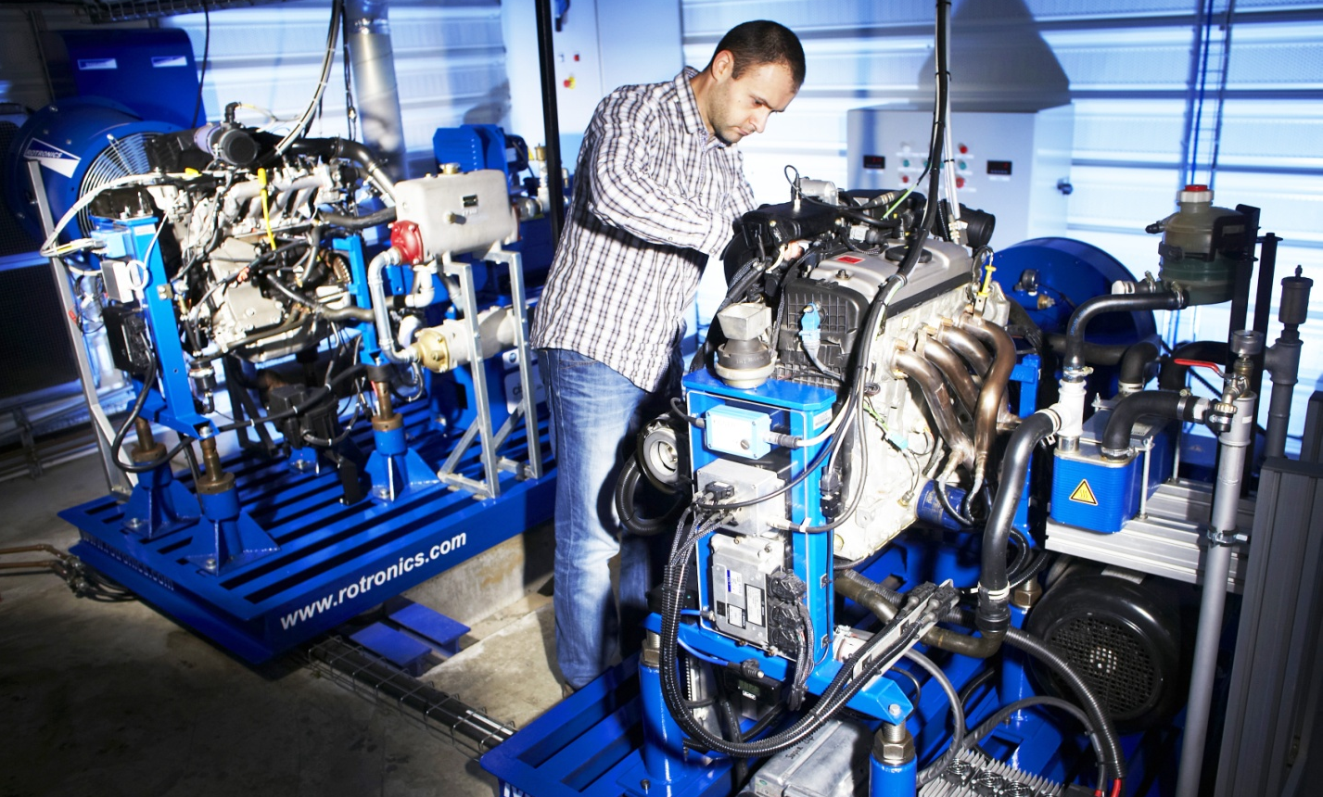
« Inventing transport for the future that is more ecological, safer, more reliable and more accessible. »
> A multidisciplinary University professionaly oriented
> 8 faculties
> 8 research laboratories
> Various facilities for a better campus life

Slide 3
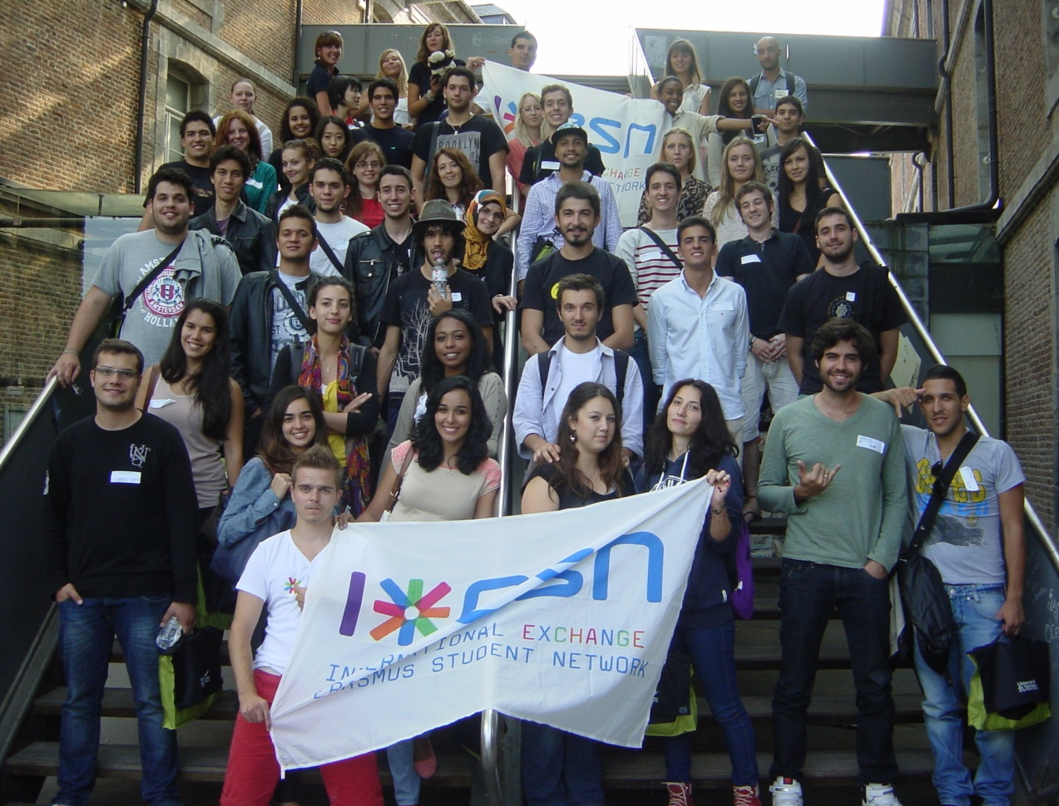
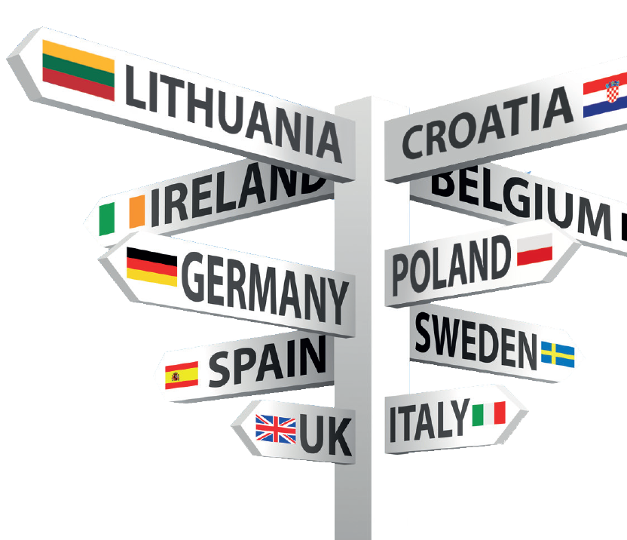
INTERNATIONAL - UVHC
> French Intensive Summer programme preparing for successful studies (scholarship covering tuition fees for Erasmus+ students)
& French classes during the year.
> Integration Seminar with welcome & orientation from August, 29th, to 31st, 2016
> Erasmus+ daytrips organised from September to May to discover Upper France
> 232 exchange agreements with organisations and institutions
> 177 partner Universities in 45 countries, including 77 Erasmus+ partner HEI
> 2 courses taught in English (Vocational Bachelor International Trade and Master Transportation & Energy)
> 9 double degrees
> 153 study abroad and 162 internships abroad

